Slide 1
Bullying

Slide 2
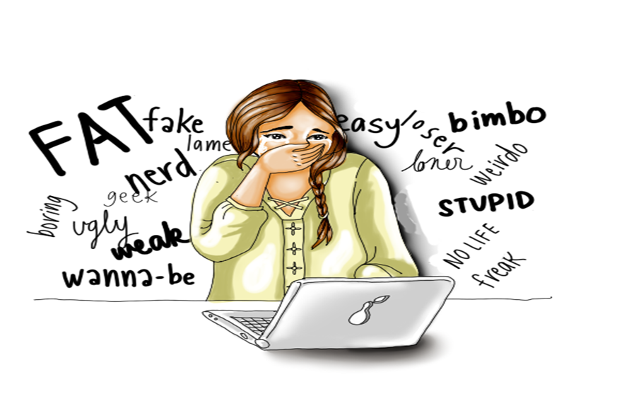
Introduction on Bullying
Bullying refers to the habitual use of coercion, threats and other forms of aggressive behavior to intimidate or dominate other people (Menesini & Salmivalli, 2017)
Bullying results to social malfunctioning to the victim
Notes:
Bullying is described as the habitual behaviour characterized by a person using aggression, threat or abuse to dominate or intimidate other people (Menesini & Salmivalli, 2017).

Slide 3
Bullying Statistics
According to the national bullying prevention centre (2020);
20.2 % of students undergo bullying while at school
Physical bullying is higher in males than females
School-based bullying prevention programs decrease bullying by up to 25%.
Notes:
Bullying statistics from the national bullying prevention center indicate that males are more likely than females to undergo physical bullying. In addition, 20.2 % of bullying happens within school premises. Bullying prevention programs in developed by schools tend to reduce bullying by approximately 25%.

Slide 4
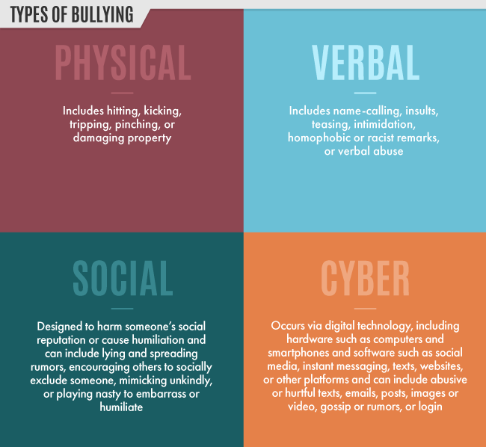
Forms of Bullying
  The major forms of bullying in society include;
    Physical bullying
    Social bullying
    Verbal bullying
    Cyber-bullying (Olweus & Limber, 2018).
Notes:
There are different forms of bullying namely; physical bullying social bullying, verbal bullying and cyber bullying. Physical bullying involves causing long term or short-term damage by kicking, punching, hitting or pushing the other person. Social bullying takes place behind a persons back with the intention of ruining their reputation. Some forms of social bullying include spreading rumors, telling others to exclude certain people in activities and playing mean jokes to humiliate the other person.
Verbal bullying takes the form of making racist or homophobic comments about other people, teasing, hurling insults and physical intimidation. On the other hand, cyberbullying is a form of bullying that is done through the use of electronic devices such as phones and computers (Olweus & Limber 2018). Cyberbullying can be in the form of sending hurtful messages, videos or images about other people so they can be humiliated online.

Slide 5
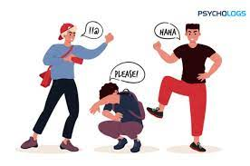
Forms of Bullying
Verbal bullying
Calling Names
Gossiping
Threating
Making Fun of someone or something
Notes:
Verbal bullying involves mainly insults, taunts, name calling, and other types of verbal abuse. Nowadays, it often occurs via social media as well. Verbal bullying is not limited to children in the schoolyard, either. Adults are often some of the worst offenders for committing vicious verbal bullying. Verbal bullying, regardless of the age of the bully and the bullied, can start off harmlessly enough – as teasing or a slight insult. But this can quickly escalate into verbal violence that causes serious harm to its victim. It also often escalates to physical bullying.

Slide 6

Mental Bullying
Name calling
Yelling
Insulting the person
Swearing at them
Isolating the person
Notes:
It is the act of using words and emotions to hurt someone’s reputation or humiliate them. Mental bullying takes different forms such as swearing at the other person, excluding the person from a group , name calling and also yelling at them. All these actions constitute to mental bullying. Mental bullying results to serious long-term psychological effects on the victim.

Slide 7

Social Bullying
Leaving someone out on purpose
Telling other children not to be friends with someone
Spreading rumors about someone
Embarrassing someone in public
Notes:
Bullying is generally defined as a form of unwanted, aggressive behavior among school-age children that involves a real or perceived power imbalance and that is repeated, or has the potential to be repeated, over time. Social bullying takes the forms of spreading rumuors about other people to damage their reputation, leaving a group or an individual out of an event or activity and also humiliating others in public by saying mean things about their appearance or pulling nasty pranks on them.

Slide 8
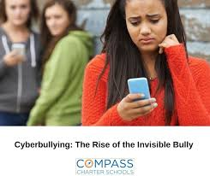
Cyberbullying
Emails
Text
Social media
Chat rooms
Facebook
Instagram
Tik Tok
Notes:
Cyberbullying is bullying that takes place over digital devices like cell phones, computers, and tablets. Cyberbullying can occur through SMS, Text, and apps, or online in social media, forums, or gaming where people can view, participate in, or share content. An excellent example of cyberbullying is when a bully opens an online pseudo account and uses it to abuse others on the internet or post stories and photos that are false in order to embarrass the other person.

Slide 9
Why People Bully Others
There are a number of reasons why people bully others, including;
Need to maintain control over other people's life
Previous victim of bullying
To gain popularity
Peer pressure
Notes:
There are several reasons why people bully others. One of the primary reasons people bully others is to maintain control over the victim's life. Most bullies lack empathy and therefore feel a need to dominate other people's life. Some bullies often become bullies after they have become victims of bullying themselves. Most bullies also develop their behavior in order to gain popularity in school so others can fear them. Bullies also develop the habit due to peer pressure to bully others so they can impress their friends.

Slide 10

Signs that a Child is being Bullied
  Some of the signs that a child is being bullied are;
    Unexplained bruises, cuts and scratches
    Changes in eating habits
    Challenges in sleeping
    Loss of interest in school
    Declining self-esteem
Notes:
There are some signs which are noticeable when a child is being bullied. One can tell if a child is being bullied if they have unexplained injuries most of the time.
If a child happens to show a shift in eating habits, there is a likelihood that they are being bullied. For example, if a child comes from school and eats a lot of food, that could be an indicator that they do not eat their lunch at school. If children begin to have frequent nightmares or lose sleep, it may also be a sign they are being bullied. If a child is being bullied in school, they are likely to lose interest in school attendance, schoolwork and try to make excuses to miss school. Declining self-esteem in a child is also a sign that others are bullying them.

Slide 11

Signs that a child is a bully
Some of the signs that prove your child might be the bully are;
  Gets into physical or verbal fights
  Unexplained new belongings or money
  Increased aggression
  Gets frequent detention
  Blames other people for their mistakes
Notes:
There are certain signs that can be used to tell if your child is the one bullying others. If a child keeps getting into physical and verbal fights with their peers, this could be a sign that they are a bully. Increased display of aggressive behavior in a child is also an indicator that they are a bully. If a child keeps getting detention in school continuously because of aggressive behavior, they are likely to be a bully in school. If a child keeps blaming other people for their mistakes instead of owning up to them, this is a sign that they are a bully. If a child has accumulated extra money and belongings that they can not explain where they got from then, there is a high chance that they are bullying others.

Slide 12
Effects of Bullying
Bullying has several adverse effects, and these include:
  Social isolation
  Increased likelihood of substance abuse
  Low self-esteem
  Chronic depression (Arseneault, 2017)
  Suicidal attempts
  Poor school performance
Notes:
Bullying has serious short-term and long-term effects on individuals including; victims of bullying often tend to self-isolate and most hours alone to avoid being further humiliated or harmed by the bullies. Victims of bullying also tend to develop low self-esteem, especially if they are being bullied for their physical appearances. Victims of bullying also develop chronic depression if the bullying goes unnoticed for extended periods (Arseneault, 2017). This may translate to suicide attempts. Children who are bullied in school also tend to have poor academic performance because they feel demotivated and threatened while in the school environment. Both the victim and the bully may end up adopting the behavior of drug use as a means of trying to escape from their realities.

Slide 13
How to Stop Bullying in Society
Major ways that bullying can be stopped in society include;
    Educating the community
    Setting clear rules regarding bullying
    Creating an atmosphere for conversations about bullying
    Encouraging bystanders to be upstanders
    Recognizing and responding to bullying incidences
Notes:
There is a variety of ways which can be used to attempt to stop bullying in society. One of the ways that bullying can be stopped is by educating community members about what bullying is and how to recognize and deal with bullying issues in society. The other step that can be taken towards stopping bullying is creating an environment that is safe for victims of bullying to speak up. Encouraging bystanders to speak up and protect the people who are being bullied also helps to reduce bullying. After a bullying case is identified, the issue must be responded to with immediacy to ensure the victim and the bully are dealt with using the proper measures. The other way of stopping bullying in society is setting clear rules that guide people's behavior with regard to bullying. The rules should indicate the repercussions of bullying on the bully.

Slide 14
Conclusion
Bullying is a serious issue that involves the habitual harassment of others either;
  Online
  Physically
  Socially
  Verbally
The effects of bullying Include;
  Low self-esteem
  Suicidal attempt
  Social isolation
Notes:
In conclusion, bullying in society is a serious problem that takes place when one person or group harasses others either physically, socially, verbally or online. The side effects of bullying are adverse on individuals including; low self-esteem, suicidal attempts, and social isolation. There are several ways to ensure that bullying is stopped including calling out bullies, encouraging by standers to protect bullying victims instead of doing nothing about the situation and also establishing school based programs that can help reduce bullying cases within the school premises.

Slide 15
References
Arseneault, L. (2017). The long‐term impact of bullying victimization on mental health. World psychiatry, 16(1), 27.
Menesini, E., & Salmivalli, C. (2017). Bullying in schools: the state of knowledge and effective interventions. Psychology, health & medicine, 22(sup1), 240-253.
Olweus, D., & Limber, S. P. (2018). Some problems with cyberbullying research. Current opinion in psychology, 19, 139-143.

